Slide 1
CSE – 101
Lets have some Motivation

Slide 2
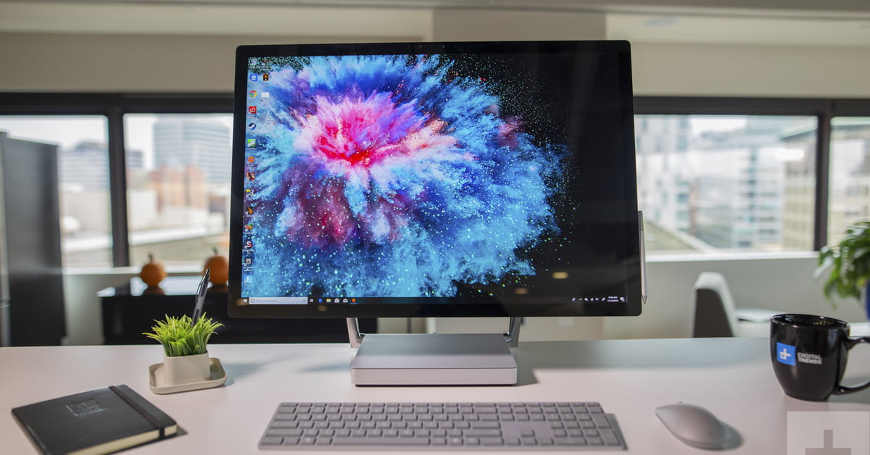

Slide 3
Business
A computer has high speed of calculation, diligence, accuracy, reliability, or versatility which has made it an integrated part in all business organizations.
Computer is used in business organizations for −
Payroll calculations
Budgeting
Sales analysis
Financial forecasting
Managing employee database
Maintenance of stocks, etc.

Slide 4
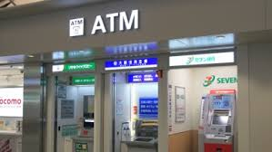
Banking and Insurance
Online accounting facility
ATM service
Insurance companies are keeping all records up-to-date with the help of computers

Slide 5

Education
The computer provides a tool in the education system known as CBE (Computer Based Education).
CBE involves control, delivery, and evaluation of learning.
Remote learning
ULAB Moodle
From course registration to result publication

Slide 6

Marketing
Advertisement
Online Shopping

Slide 7
Healthcare
Diagnosis: X-Ray, MRI, CT Scan
Patient Monitoring: These are used to check the patient's signs for abnormality such as in Cardiac Arrest, ECG, etc.
Pharma Information System: Computer is used to check drug labels, expiry dates, harmful side effects, etc.
Surgery

Slide 8
Engineering Design
Structural Engineering − Requires stress and strain analysis for design of ships, buildings, budgets, airplanes, etc.
Industrial Engineering − Computers deal with design, implementation, and improvement of integrated systems of people, materials, and equipment.
Architectural Engineering − Computers help in planning towns, designing buildings, determining a range of buildings on a site using both 2D and 3D drawings.

Slide 9
Communication
E-mail
Chatting
Video-conferencing
Social Networking
Blogging
Content Sharing : Youtube

Slide 10
Government
Budgets
Sales tax department
Income tax department
Computation of male/female ratio
Computerization of voters lists
Computerization of NID card and Passport
Weather forecasting

Slide 11
Military
Missile Control
Military Communication
Military Operation and Planning
Smart Weapons

